Slide 1

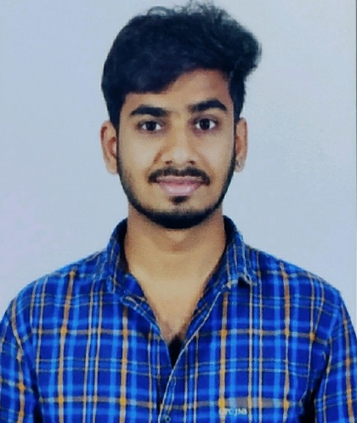





Chandana Naga Venkata Madhu Pavan
Education and certificates
Bachelor of Technology In
Electronics And Communication Engineering : 2017 - 2021
Analyst/Software Engineer
Base Location: Bangalore
Skills
React Framework
Database
Spring Boot
Spring MVC
Bootstrap
Node JS
Email ID:
Chandana-naga.Venkata-madhu-pavan@Capgemini.com
_{Mobile No : +91 9182744118}
Grade:
A4
Strengths
A self driven learner with Front-End and Back-End knowledge. Passionate about implementing and launching new projects.
Ready to learn new technologies/frameworks and implement them to further improve my knowledge.
A team player with good communication skill always ready to work for the enrichment of knowledge.
Has working knowledge on React and Java Microservice Development using Spring framework on an beginner level.
Achivement
Mumbai Dabbawala Food Delivery Application
Backend
Spring Boot
Spring MVC
REST-API
Database
Postgre SQL
My SQL
Oracle SQL
Completed end to end case study of Mumbai Dabbawalla food delivery with the help of Spring boot and Postgre SQl database. React framework used for user interface.
Designed Static and Dynamic Web Pages
Developed website with HTML5 and CSS3 along with React framework to make website more interactive and colorful.
Web Technologies
HTML5
CSS 3
JavaScript
Bootstrap
Certifications
Full Stack Java development certification from Pentagon Institute, Bangalore, Vijayanagar
AWS Certified Cloud Practitioner
Add-ons
GitHub
Maven
Postman
Additional Details
Excellent Communication Skills
Leadership quality
Have decent knowledge on Databases like Oracle
SQL, My SQL and Postgres SQL
Check out my work on GitHub & Video Profile
Presentation Title | Author | Date © Capgemini 2017. All rights reserved | 1

